Slide 1

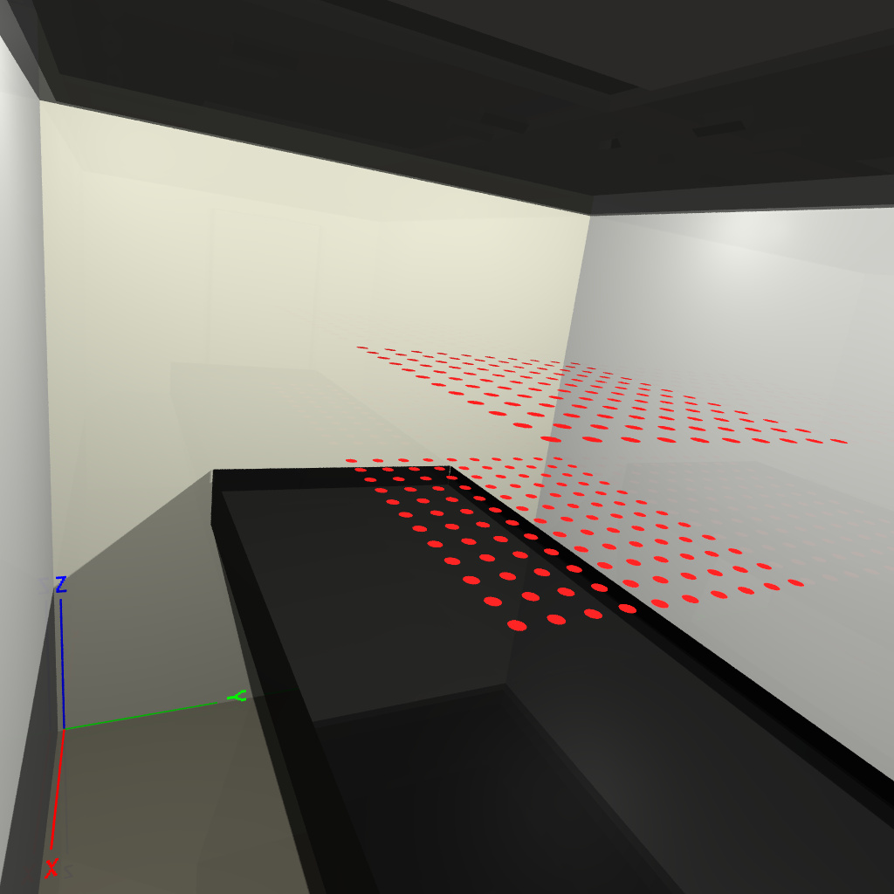
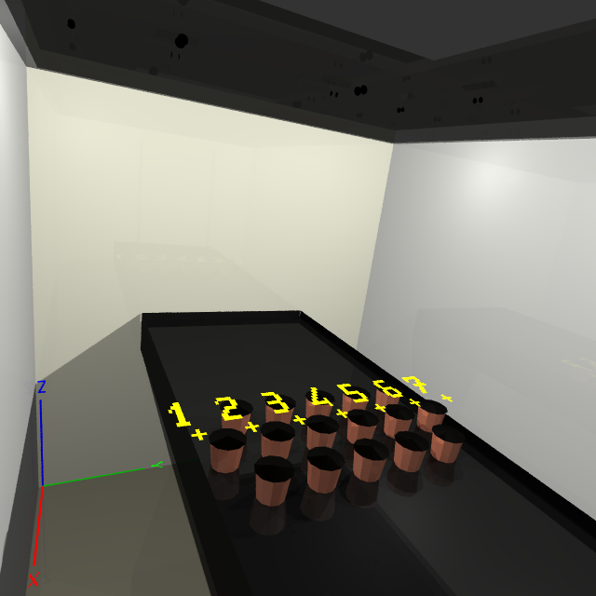
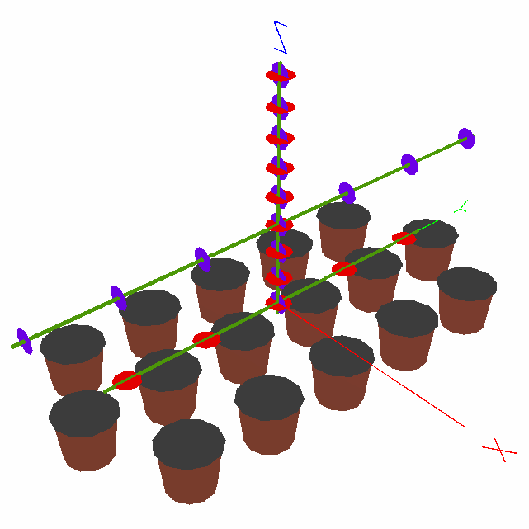
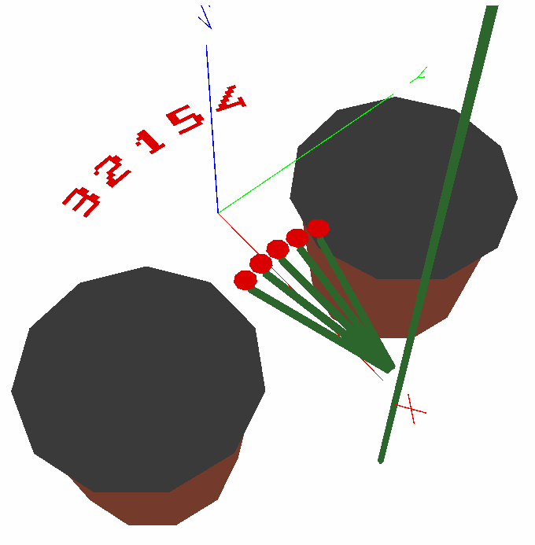
A
A
B
C
D
Fig. 2. Position of the light sensors in Exp. 1 (A) and Exp. 2 (B,C,D).
(A) In Exp. 1, sensors were positioned on two planes in a quarter of the empty growth chamber, 10 and 50 cm above the table. (B) In Exp. 2, 16 plants were positioned in three staggered rows, with the central row positioned at the center of the growth chamber, only the pots are represented here. Seven sites (yellow crosses) were defined along the central row: they were evenly spaced, either half-way between two successive plants (sites 2 to 6), or beyond each border plant (sites 1 and 7). (C) Sensor was moved along a vertical transect at the center of the growth chamber (vertical to site 4), each 5 cm from 10 to 50 cm above the table, with sensor pointing either upward (red spots) or sideward (blue spots). Sensor was also moved along two horizontal transects, one at 10 cm above the table vertically from sites 2 to 6, sensor pointing upward (red dots); and a transect at 25 cm above the table vertically from sites 1 to 7, sensor pointing sideward (blue dots). (D) For each position of the sensor described in (C), four complementary positions of the sensor were used, two on either side of the central point, represented by red dots 2, 3, 4, 5 as shown in (D). These measurement points were 1 cm distant of their closest neighbor (i.e 8° of rotation of a 72 mm stem around a vertical rotation axis).
Ne pas diffuser svp

